Slide 1
UESTC1008: Microelectronic Systems
Shift Registers
Lecture 12
Qammer H. Abbasi, Lei Zhang, Sajjad Hussain, Muhammad Ali Imran and Guodong Zhao
{qammer.abbasi,Lei.zhang,sajjad.Hussain,Muhammad.Imran,guodong.zhao}@glasgow.ac.uk

Slide 2
Overview
The following topics are covered in this lecture:
  Register
  Shift Registers
  Ring Counter
  Johnson Counter
  Transmission of Data
    Serial Format
    Parallel Format

Slide 3
Register
A register is a group of binary cells
In a computer, a register is one of a small set of data holding places that are part of a computer processor
A register may hold a computer instruction, a storage address, or any kind of data (such as a bit sequence or individual characters)

Slide 4
Shift Registers
Circuit for simple shift register
Basic applications
  Ring counters
  Johnson counters
  Pseudo-random binary sequences and encryption
  Ready-made shift registers are available as integrated circuits, such as the ’165
Conversion of data from serial to parallel and vice versa
  Large-scale devices such as ‘universal asynchronous receiver transmitters’ (UARTs) are based on shift registers
  Same functions available in microcontrollers (‘shift’ and ‘rotate’ instructions)

Slide 5
Basic Shift Register
A basic shift register is simply a chain of D flip-flops with a common clock.
Q_{A}
Q_{B}
Q_{C}
Q_{D}
serial input
D Q
D Q
D Q
D Q
serial output
A
B
C
D
clock
Each flip-flop transfers its D input to its Q output at a clock transition.
The effect is to transfer data along the register, one flip-flop per clock cycle.
This type of register is called a serial input-serial output (SISO).

Slide 6
Basic Shift Register
A basic shift register is simply a chain of D flip-flops with a common clock.
Q_{A}
Q_{B}
Q_{C}
Q_{D}
serial input
01001110
D Q
D Q
D Q
D Q
serial output
A
B
C
D
clock
The table shows the contents of the register after successive clock transitions. The assumption is that the register is initially clear.
The number of clock pulses needed to fill the register is equal to the number of flip-flops used to make the register.
  This is a 4 bit register.

Slide 7
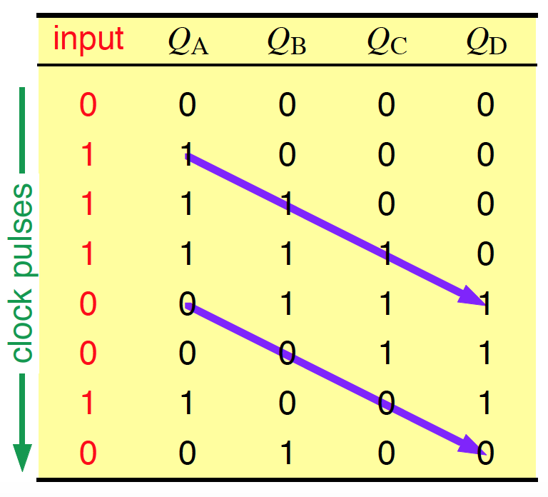
Basic Shift Register
A basic shift register is simply a chain of D flip-flops with a common clock.
Q_{A}
Q_{B}
Q_{C}
Q_{D}
serial input
01001110
D Q
D Q
D Q
D Q
serial output
A
B
C
D
clock
The table shows the contents of the register after successive clock transitions. The assumption is that the register is initially clear.
The number of clock pulses needed to fill the register is equal to the number of flip-flops used to make the register.
  This is a 4 bit register.

Slide 8
Timing for a Shift Register
clock
input
Q_{A}
Q_{B}
Q_{C}
Q_{D}
tpd
The pattern in successive flip-flops moves to the right with each clock cycle to shift the pattern into and out of the register.

Slide 9
Timing for a Shift Register
clock
input
Q_{A} Q_{B}
Q_{C}
input
Q_{A} Q_{B} Q_{C}
Q_{D}
Q_{D}
0
0
0
0
0
0
0
0
tpd
1
1
1
1
1
1
0
1
1
0
0
1
0
0
1
1
1

Slide 10
Applications of a Basic Shift Register
Delay line — N stages delay the signal by N clock cycles
Multiplication and division by powers of 2, because this just requires a shift of the binary number (like multiplication or division by 10 in decimal)
  Example: decimal 3 x 4 = 12 becomes 11 x 100 = 1100 in binary The arithmetic logic unit (ALU) of a computer processor uses a shift register for this purpose.
Warning: the ‘sense’ of a shift — left or right — is usually based on its effect on binary numbers written in the usual way. For example,
  11 → 1100 is called a left shift. This is clearer if both numbers are written with 8-bits as 00000011 → 00001100. Similarly, dividing by 2 such as 00010110 → 00001011 is a right shift

Slide 11
Ring Counter
A shift register with its output fed back to its input forms a ring counter.
Q_{A}
Q_{B}
Q_{C}
Q_{D}
D Q
D Q
D Q
D Q
output
clock
A B C D
This can be used to generate an arbitrary binary pattern of length N, where N is the number of stages in the ring counter. It must be preloaded with the sequence desired, which then rotates around the counter indefinitely

Slide 12
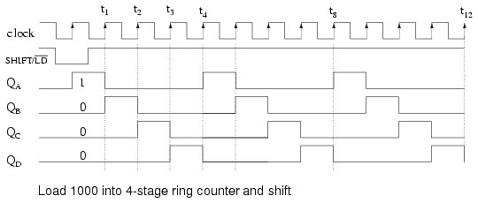
Ring Counter
One application is to divide down the clock frequency for a slower part of a digital system, while keeping everything synchronous. Modern computers have several ‘buses’ running at different speeds, where a ring counter is used to create the clocks for the various buses
1000 0100 0010 0001 1000 0100 …
The circuit above is a divide by 4 counter. Comparing the clock input to any one of the outputs, shows a frequency ratio of 4:1.

Slide 13
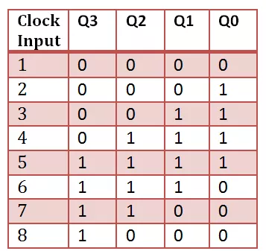
Johnson Counter
A ring counter with the complement of its output fed back is a Johnson counter.
D Q
D Q
D Q
D Q
output
clock
A B C
D
This generates longer sequences than a simple ring counter.
For example, a ring counter with 4 stages produces a cycle of 4 states — a waste as there are 2⁴ = 16 states in all.
A Johnson counter with 4 stages has a cycle of 8.

Slide 14
Pseudo-random Number Generator
A ring counter with feedback through an Exclusive-OR gate makes a simple pseudo-random number generator.
D Q
D Q
D Q
D Q
output
Pseudo-random sequences of 1s and 0s have many applications, notably in encryption. They appear to be random over ‘short’ times but the sequence eventually repeats, hence the more accurate term ‘pseudo-random’
Also, they can be reproduced perfectly if you know both:
the method used to generate the sequence
the state in the sequence at which to start
This is an important feature! — see next sheet.
The circuit above has a period of 2⁴ – 1 = 15
(the missing state is 0000 —why?).

Slide 15
Pseudo-random Binary Sequences and Encryption
your data (plain text)
pseudo-random binary sequence
sender
exclusive or
transmit data over insecure link
looks like binary ‘noise’ — apparently random
receiver
?

Slide 16
Pseudo-random Binary Sequences and Encryption
your data (plain text)
pseudo-random binary sequence
sender
exclusive or
transmit data over insecure link
looks like binary ‘noise’ — apparently random
same pseudo-random binary sequence
receiver
?
if you exclusive-or a bit
exclusive or
with the same value (0 or
1) twice, you get the initial value back again.
your data in plain text again

Slide 17
Pseudo-random Binary Sequences and Encryption
your data (plain text)
pseudo-random binary sequence
sender
exclusive or
How do we ensure that both sender and receiver use the same pseudo- random binary sequence?
transmit data over insecure link
looks like binary ‘noise’ — apparently random
same pseudo-random binary sequence
receiver
?
if you exclusive-or a bit
exclusive or
with the same value (0 or
1) twice, you get the initial value back again.
your data in plain text again
This is the basis of the method used to encrypt data sent over the internet
(https) or with a digital mobile phone.

Slide 18
Transmission of Data — Serial Format
Data often has to be transmitted from one computer to another, or from a computer to peripheral equipment (printer, modem, …). This can be done in:
serial format, one bit at a time
parallel format, several bits at a time (e.g. byte at a time, 8 bits)
Serial format is most commonly used because it is simpler. Only a few wires are needed:
traditional serial ‘COM’ ports (RS-232) need only 3 wires (transmitted data, received data and ground — but more may be used for control)
universal serial bus (USB, common on modern computers) uses 4 wires (two for differential data plus power and ground)
Traditional serial transmission was slow but modern systems use much faster rates (USB version 1 up to 12 Mbits per second, FireWire 1 up to 400 Mbits per second), version 2 of both even faster
simple serial
1 0 0 1 1 0 1 1 0 1 0 1
bit stream

Slide 19
Parallel Data
Where higher speed is required, several bits (usually a small number of bytes, each of 8 bits) may be moved at once. More complicated connections are needed — more wires. Common applications include:
inside the processor itself, e.g. our microcontroller handles bytes
inside a computer system on the bus (e.g. PCI) and interfaces to disk drives (e.g. IDE)— but these are now mainly serial
Interfaces have changed to serial because it is hard to ensure that all bits on a parallel bus arrive at the same time at the high speed of modern systems.
Notes:
IDE: Integrated Device Electronics PCI: Peripheral Component Interconnect

Slide 20
Parallel Data
Where higher speed is required, several bits (usually a small number of bytes, each of 8 bits) may be moved at once. More complicated connections are needed — more wires. Common applications include:
inside the processor itself, e.g. our microcontroller handles bytes
inside a computer system on the bus (e.g. PCI) and interfaces to disk drives (e.g. e.g. SCSI or IDE)— but these are now mainly serial
Interfaces have changed to serial because it is hard to ensure that all bits on a parallel bus arrive at the same time at the high speed of modern systems.
How do you interface a serial device to a computer?
How do we interface an external device that transmits serially with the bus of a computer that transfers one byte (8 bits) at a time?
Use a shift register.
In practice this would almost certainly be buried inside a larger circuit called
a UART (universal asynchronous receiver transmitter) or something similar.

Slide 21
Use of Shift Register as Parallel to Serial Converter
parallel data in
 |  | parallel load
D Q
D Q
D Q
D Q
serial output
clock
Extra logic is added to the basic shift register so that all the flip-flops can be loaded in parallel (simultaneously), controlled by a shift/load input.
Once the data have been loaded, the clock is enabled and the values are shifted once per clock cycle. This causes the input data to be transferred to the output, one bit at a time — parallel in serial output (PISO).

Slide 22
Use of Shift Register as Serial to Parallel Converter
parallel data out
 |  | parallel load
serial input
D Q
D Q
D Q
D Q
clock
A B C D
The opposite process is used to read in serial data, fill up the shift register, and transfer it in parallel to a bus when the register is full (SIPO).

Slide 23
Review Exercises
A shift register has 16 stages and is clocked at 1 MHz. How long does data take to pass through it?
We wish to multiply a binary number by 8. How can this be done with a shift register? In which direction should it operate?
Can division be done in the same way? Are there any problems?
A 4-bit ring counter is started with the pattern ABCD = 1100. What are its subsequent states after the clock is turned on?
Repeat the analysis for a 4-bit Johnson counter.
Prove that a bit returns to its original value, either 0 or 1, after two
exclusive-or operations with the same value, whether this is 0 or 1
Try to work out the sequence produced by the 4-stage pseudo-random
number generator described in the lecture. Start at ABCD = 1000. (What
would happen if you started with 0000?)

Slide 24
Dictionary
shift register - 移位寄存器
ring counter - 环形计数器
serial input - 串行输入
parallel input - 并行输入
serial output - 串行输出
parallel output- 平行输出
random number generator - 随机数生成程序
pseudo - 假的
universal asynchronous receiver transmitter - 通用异步收发两用机
universal serial bus - 通用串行总线
COM port - 串行通讯端口
exclusive-or - 异或
http://dict.youdao.com/

